Slide 1
Containers and Clusters in Azure
Ralph Squillace ralph.squillace@Microsoft.com

Slide 2
The Agenda
Two minutes on the history of Virtualization. OK, three.
Why Docker Rocks
Docker on Azure
Other Containers on Azure
Questions?

Slide 3
History of Virtualization
Operating Systems
Virtual Machines
Linux Containers (LXC)
Docker Containers

Slide 4
Abstract Benefits of Containers: Short course
Standard format everyone agrees on*****
Once you seal the box, it always gets shipped “as is”
Now concerns are properly separated:
Building them means building the same format
Packaging them means wrapping the same format
Shipping them means shipping the same format

Slide 5
Concrete Benefits of Linux Containers: Short course
Only one kernel runs on the machine
No hypervisor overhead (in the cloud, that’s a bit different)
Apps run directly on CPU
Rackspace, power, and CPU cycles freed up
Run different versions of Linux on the same server
Process isolation & basic security
Compute density and control

Slide 6
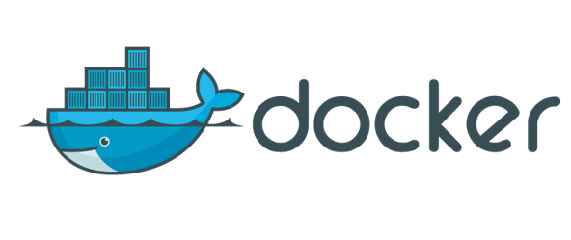
Why Docker Rocks (Why don’t we all do LXC?)
Docker is a “container engine”
What does the container look like?
Standard Image Format
How do you make images and containers available?
Daemon and client deployment tools
Shipping code to servers is hard:
Ecosystem tools
OPEN SOURCE ECOSYSTEM
So open, even Microsoft has implemented it. So it must be good.

Slide 7
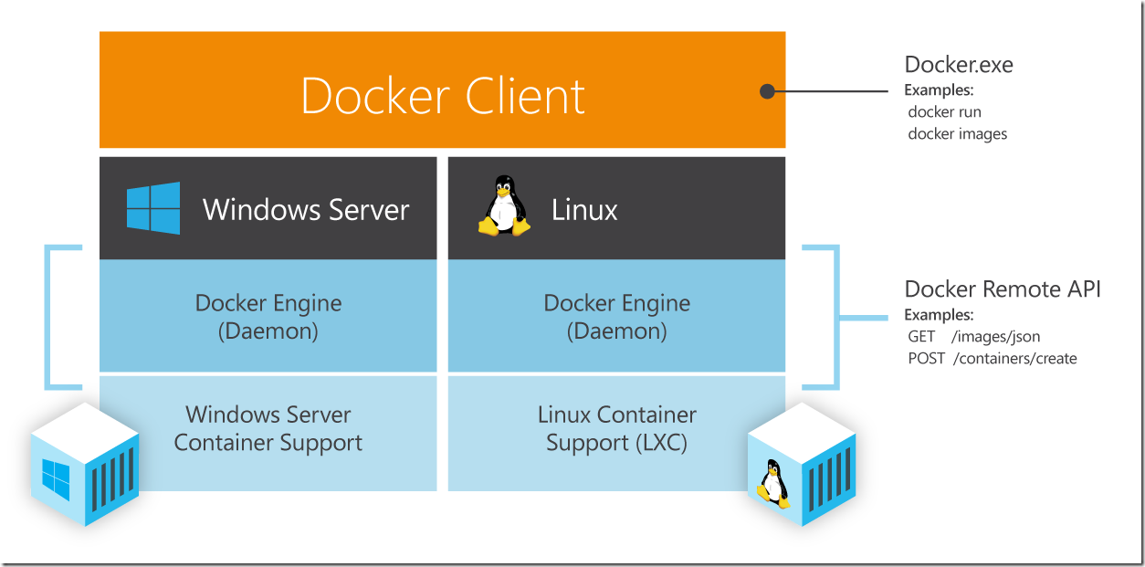
Deploy almost anywhere

Slide 8
The Destruction of Old Timey Ops
Changes
Opportunities
Ops teams reduced to shipping “containers” – no longer do they install something called “software”.
Makes less difference where the container is: cheaper public cloud resources as good as any other.
Even multiple clouds and private data centers: they all become one giant machine (if you want that)
Radically fewer traditional sysadmins. Once permissions establish the right to deploy containers, they’re not needed.
Ops can focus on super high-value targets:
Very high intensity or vast scale computing environments for containers
Distributed systems and tooling for containers
Backstopping security issues and hardening deployments, policies, and data storage and usage.
Backstopping support teams

Slide 9
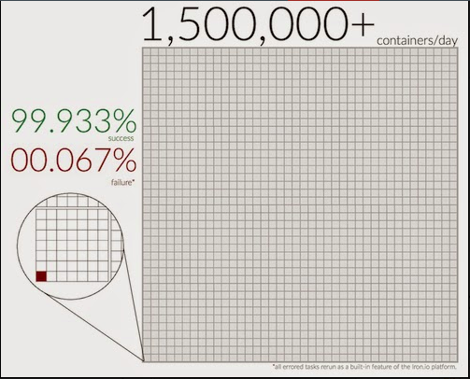
Error rates deploying containers at iron.io
Not bad, eh?
http://blog.iron.io/2014/10/docker-in-production-what-weve-learned.html

Slide 10
Docker on Azure
Automatic Best Practice deployment
Complete selection of images
Portal deployment for ease of use
Choose an image
Either we can install docker, or you can
Use your VM
Make customers happy

Slide 11
What do Microservices mean?
Tons and tons of apps….
Inside tons and tons of containers….
Running on tons and tons of VMs….
Running on tons of operating systems….
Running on a bunch of physical computers….
You’re going to need a bigger boat.

Slide 12
Make you feel a bit like this?

Slide 13
You’re going to need orchestration.
No, not BizTalk.

Slide 14
You’re going to need orchestration.
Orchestration: package management for:
VMs and data center infrastructure
Containers
Apps

Slide 15



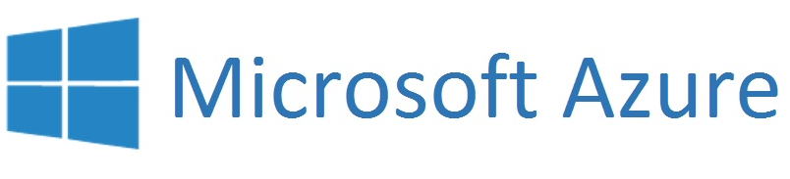
Point: The Clouds are one big machine

Slide 16

Point: The Clouds are one big machine
Docker Client

Slide 17
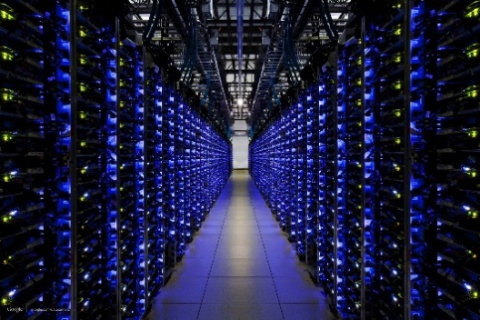
Point: The Clouds are one big machine
Docker Client
Your own cloud

Slide 18
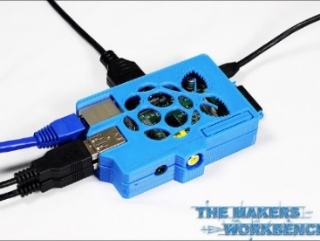
Point: The machines are one big machine
Docker Client
Your own cloud

Slide 19
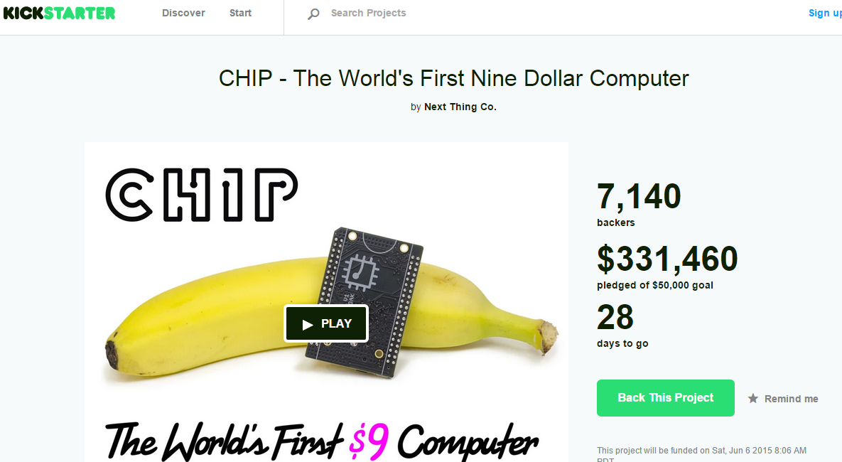
Think I’m kidding?
https://www.kickstarter.com/projects/1598272670/chip-the-worlds-first-9-computer

Slide 20
You’re going to need orchestration.
Orchestration examples

Slide 21
You’re going to need orchestration.
Chef and Puppet – configuration support
Docker, docker-machine, docker-swarm, and docker-compose – container, vm, container-clustering, and app configuration
Deis – complete deployment and Heroku pack compatibility
Flynn
Kubernetes – Google’s public orchestration system
Apache Mesos – a public version of Twitter’s orchestration system
Ubuntu’s juju, RedHat’s Project Atomic, Microsoft’s resource group templates….

Slide 22
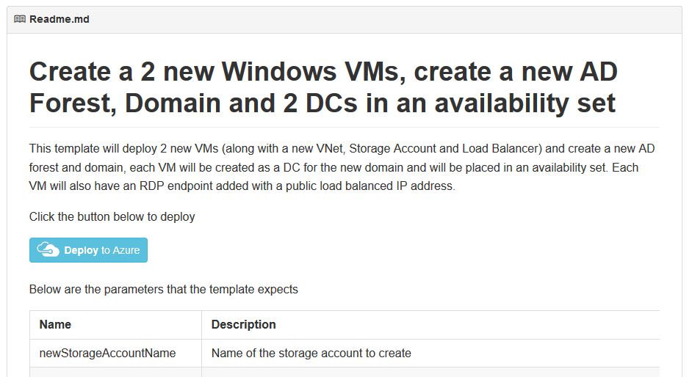
What? Wait a minute…
Yeah, Azure resource group templates.

Slide 23
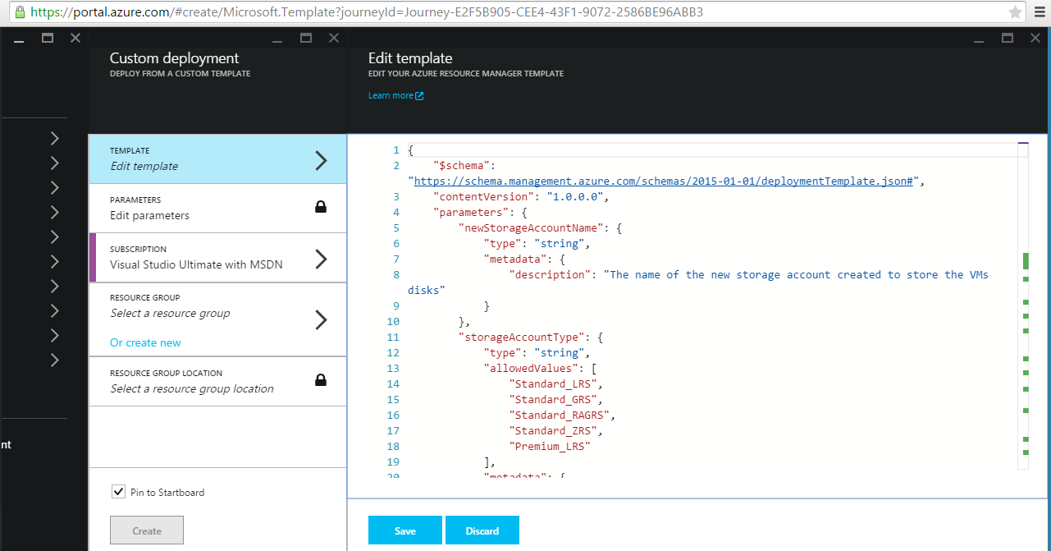

Slide 24
Demo time
DCOS-driven mesos cluster from mesosphere

Slide 25
Docker at Microsoft
This is more than just Azure

Slide 26
Docker at Microsoft
Implemented a Windows native docker client in .NET
Implementing a Docker image container service in Windows Server
Implemented support for private, signed docker image registries in Azure Storage for private, verified, and controlled image repositories
Support for docker machine, docker swarm, and docker compose
Support for specialized docker and linux container images:
CoreOS
Ubuntu Core and Snappy
Fleet
Deis
Weave
Kubernetes
Mesos

Slide 27
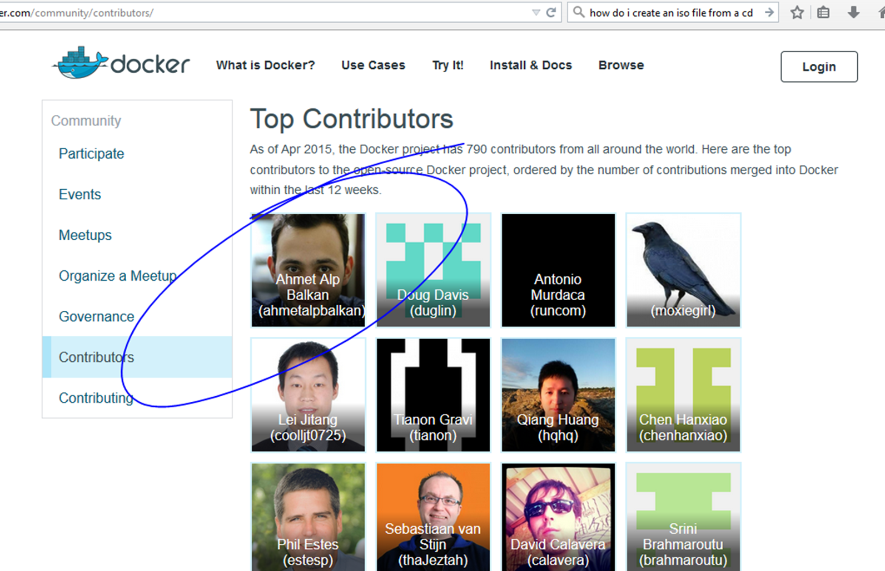
Who’s the top contributor to Docker? ☺

